Slide 1


HỌC VIỆN CÔNG NGHỆ BƯU CHÍNH VIỄN THÔNG
University graduation project
BUILDING A COLLABORATIVE SYSTEM
TO SUPPORT LEARNING
USING JAVA AND NEXTJS
ADVISOR:
PRESENTED BY:
PhD. Dao Ngoc Phong
Tran Manh Hung B21DCCN419
Nguyen Vinh Hiep B21DCAT084

Slide 2





Outline
Overview of the presentation structure and agenda.
1
2
3
4
Introduction to the project
Project analysis and design
User Interface (UI) Overview
Summary
Present the rationale for the project and the technical tools used for implementation.
Detail the requirements analysis and architectural design.
Demonstrate prominent UI pages.
Identify achievements, limitations, and future direction.

Slide 3


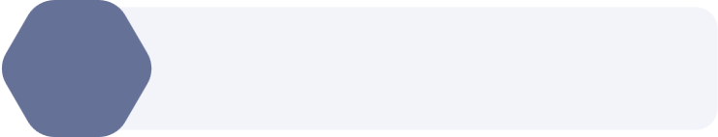

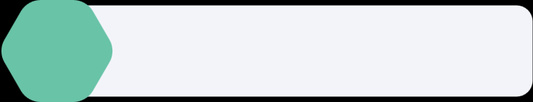
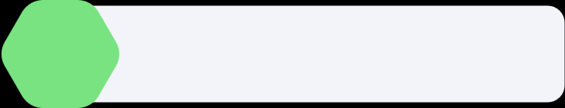
Project Selection Criteria
Introduction to the project
Problems to be solved
University graduation project
2021-2025
Technology Stack

Slide 4





Project Selection Criteria
Criteria to choose a project (and also for design functions)
01
02
03
Feasibility
Practice
Creativity
There are 4 months, and almost technique are high-level now, and the most important factor is the support from AI is very clear
Fragmentation
Unspecificied function
There are not many systems supporting the integration nowadays.
Having several creative functions ensures the unique on the larbor.

Slide 5

Problems to be solved
Show the landscape of the problems student face
Fragmentation in learning
Overwhelming scope
Collaboration: Messenger or Zalo
Shared source: Google drive
Tasks organization: Jira
Over-reliance on numerous applications can impede effective teamwork.
Many different users: Apps often are designed to be appropriate for as many users as possible.
Leading to inefficient usage for students, such as Jira, containing many redundant functions for a team of students to use
vs

Slide 6















Technology Stack
Sequential approach to transform strategic vision into operational reality
Outstanding technique
BE
Database
Google OAuth 2.0
Google Cloud Storage
NextJS
Java
Postgres
MongoDB
Redis
Apache Kafka
Hocuspocus server
FE
Third-party

Slide 7
Main use case diagrams
Project analysis and design
System architecture
University graduation project
2021-2025
Overall system database

Slide 8
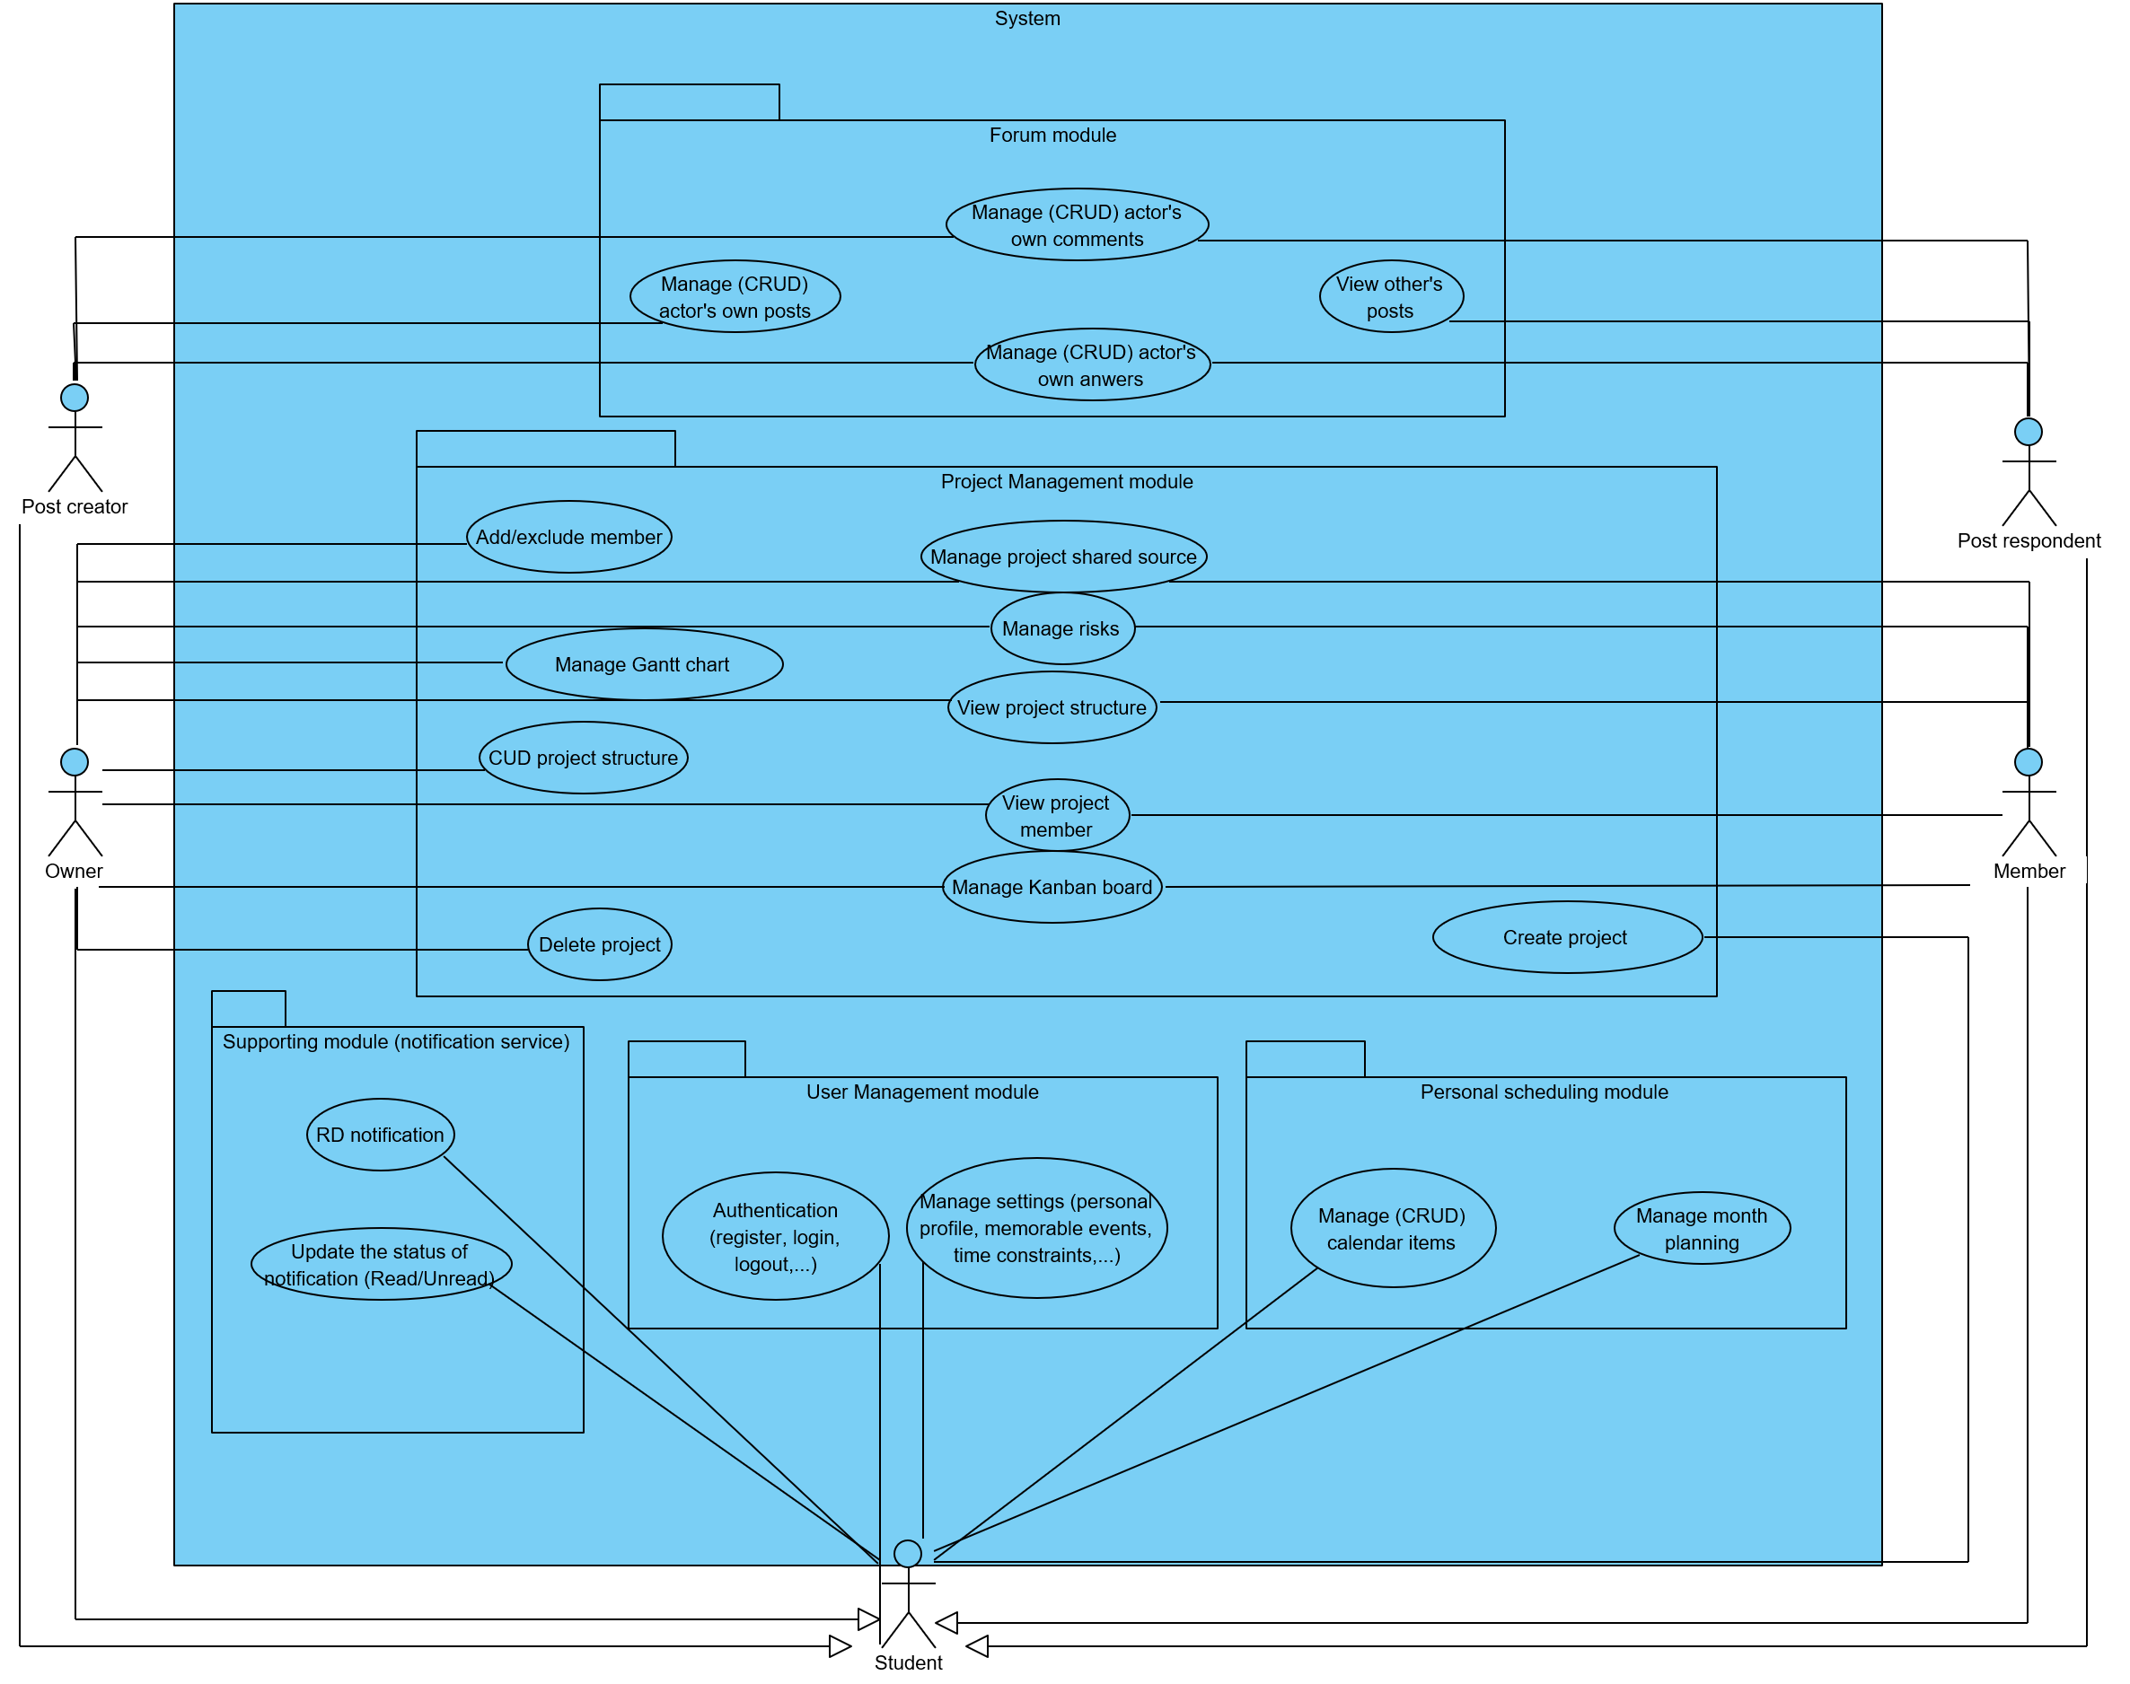
Overall UC
An overall use case diagram mapping how various actors interact with project management, scheduling, and communication modules

Slide 9

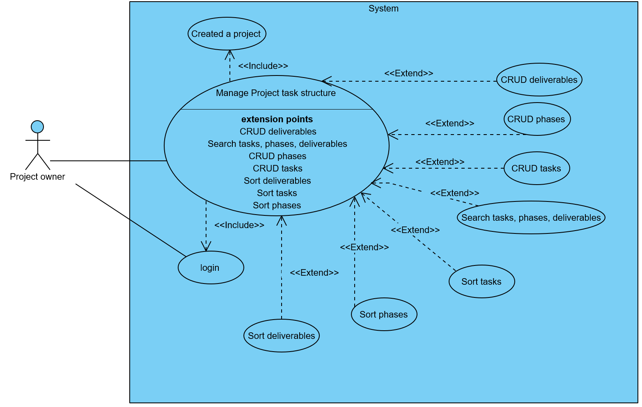
Project task structure management UC
Defining the hierarchy of work. Only the Owner can create Deliverables and Phases

Slide 10
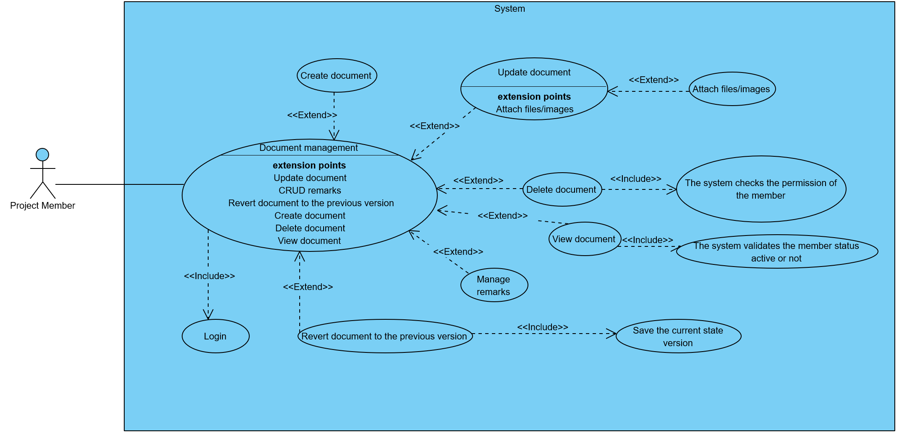
Document management UC
Showing the functionalities related to documents such as creating, reverting the document to the previous versions,…

Slide 11
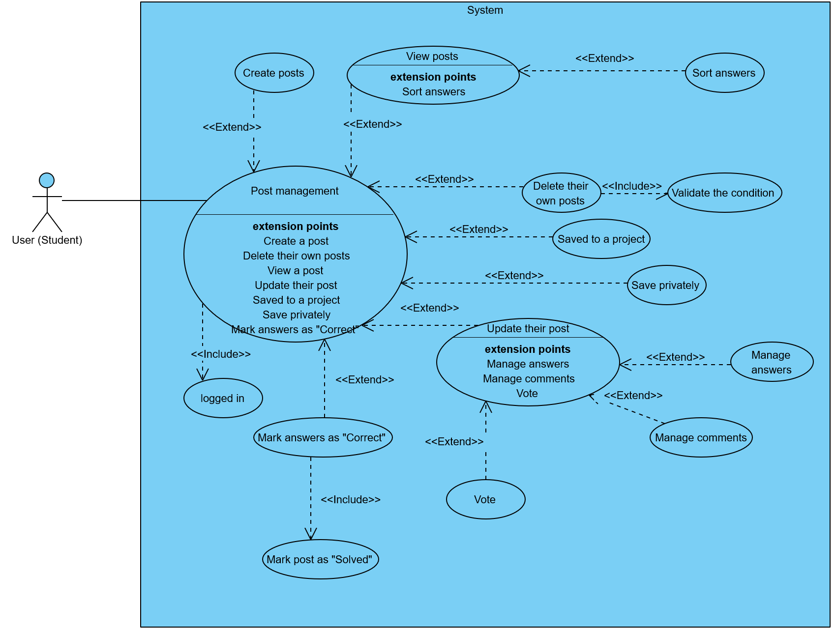
Post management UC
Facilitating academic exchange through a structured Q&A and discussion platform.

Slide 12
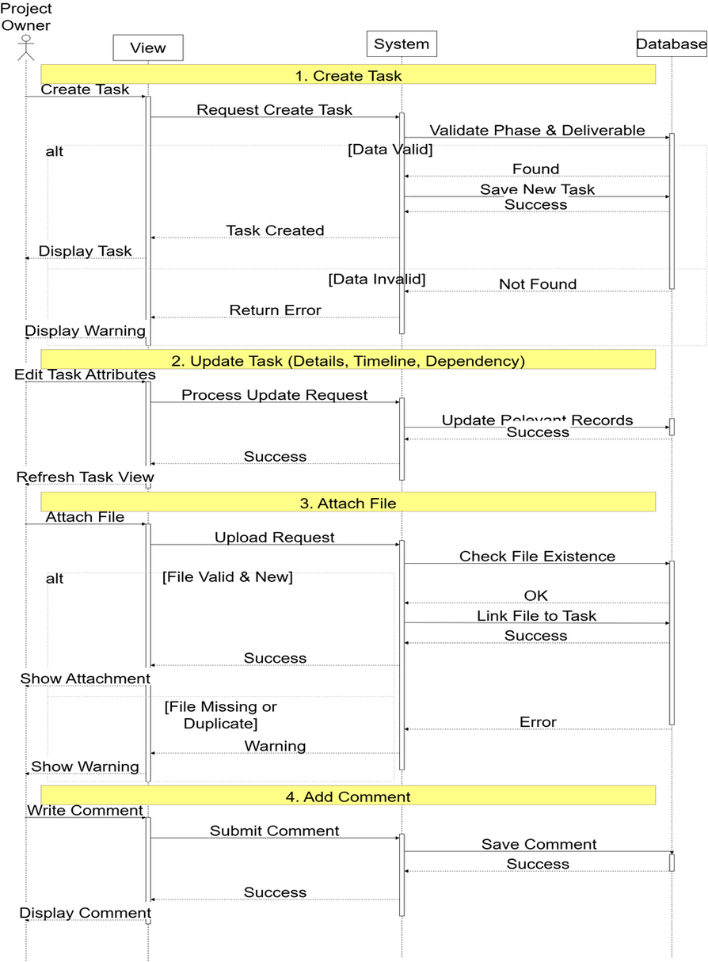
Sequence diagram for the Project task structure management UC

Slide 13
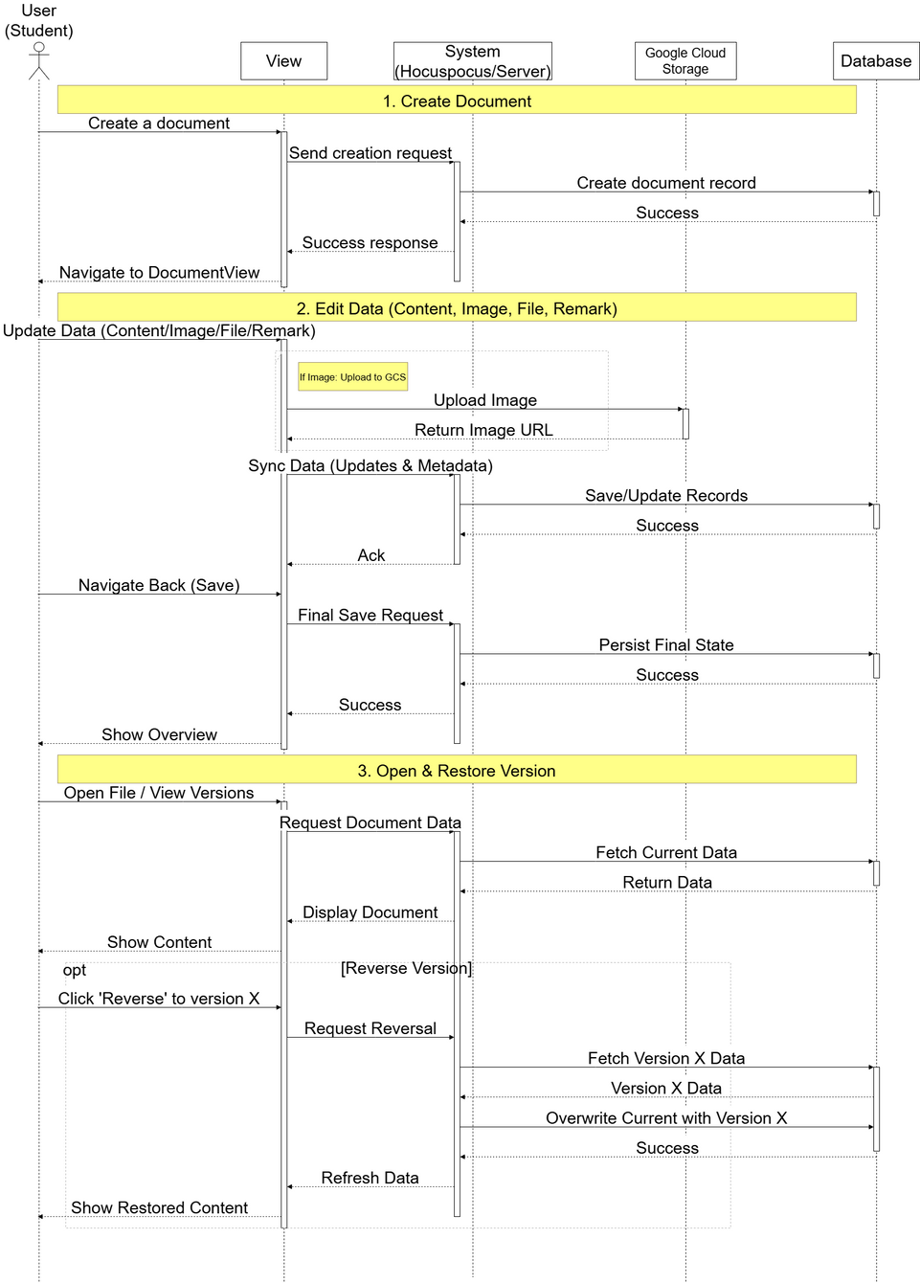
Sequence diagram for the Document management UC

Slide 14
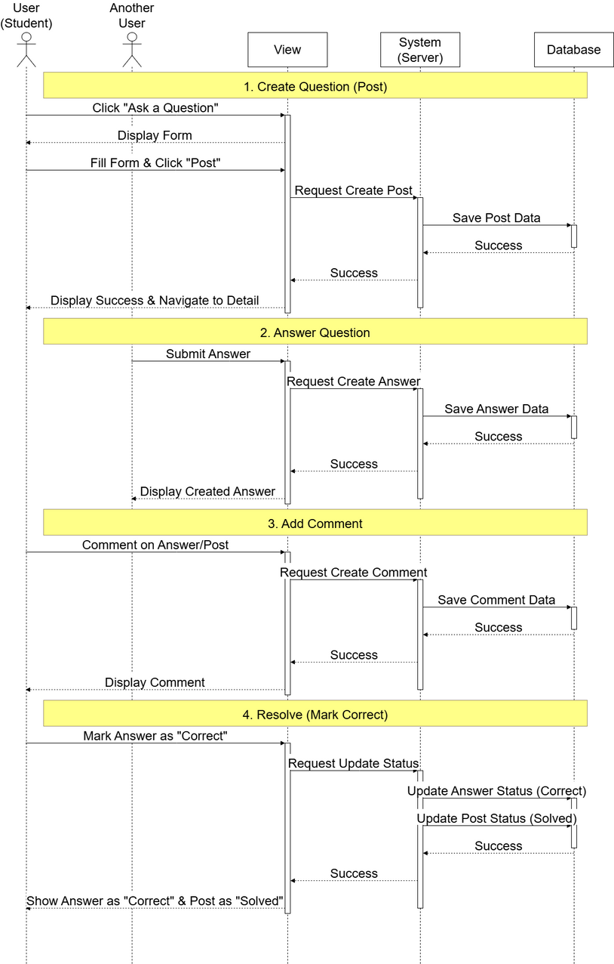
Sequence diagram for the Post management UC

Slide 15
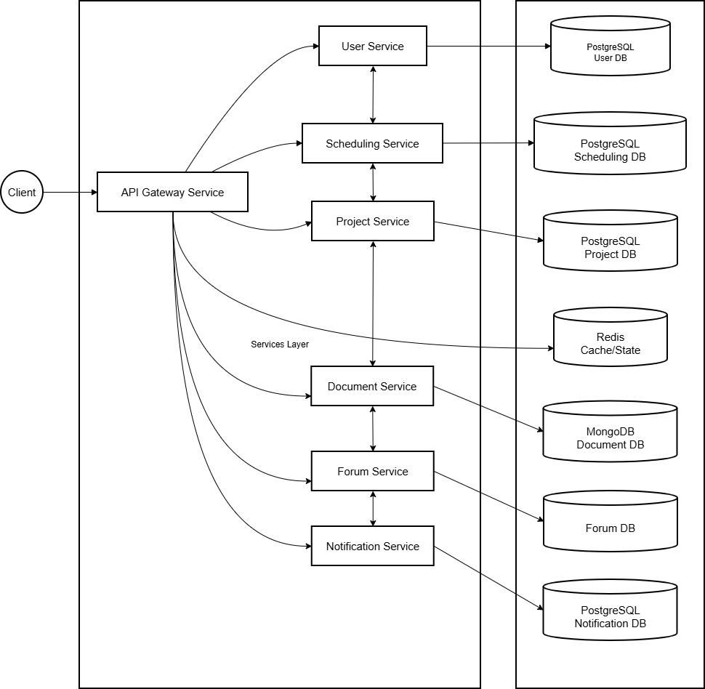
System architecture

Slide 16
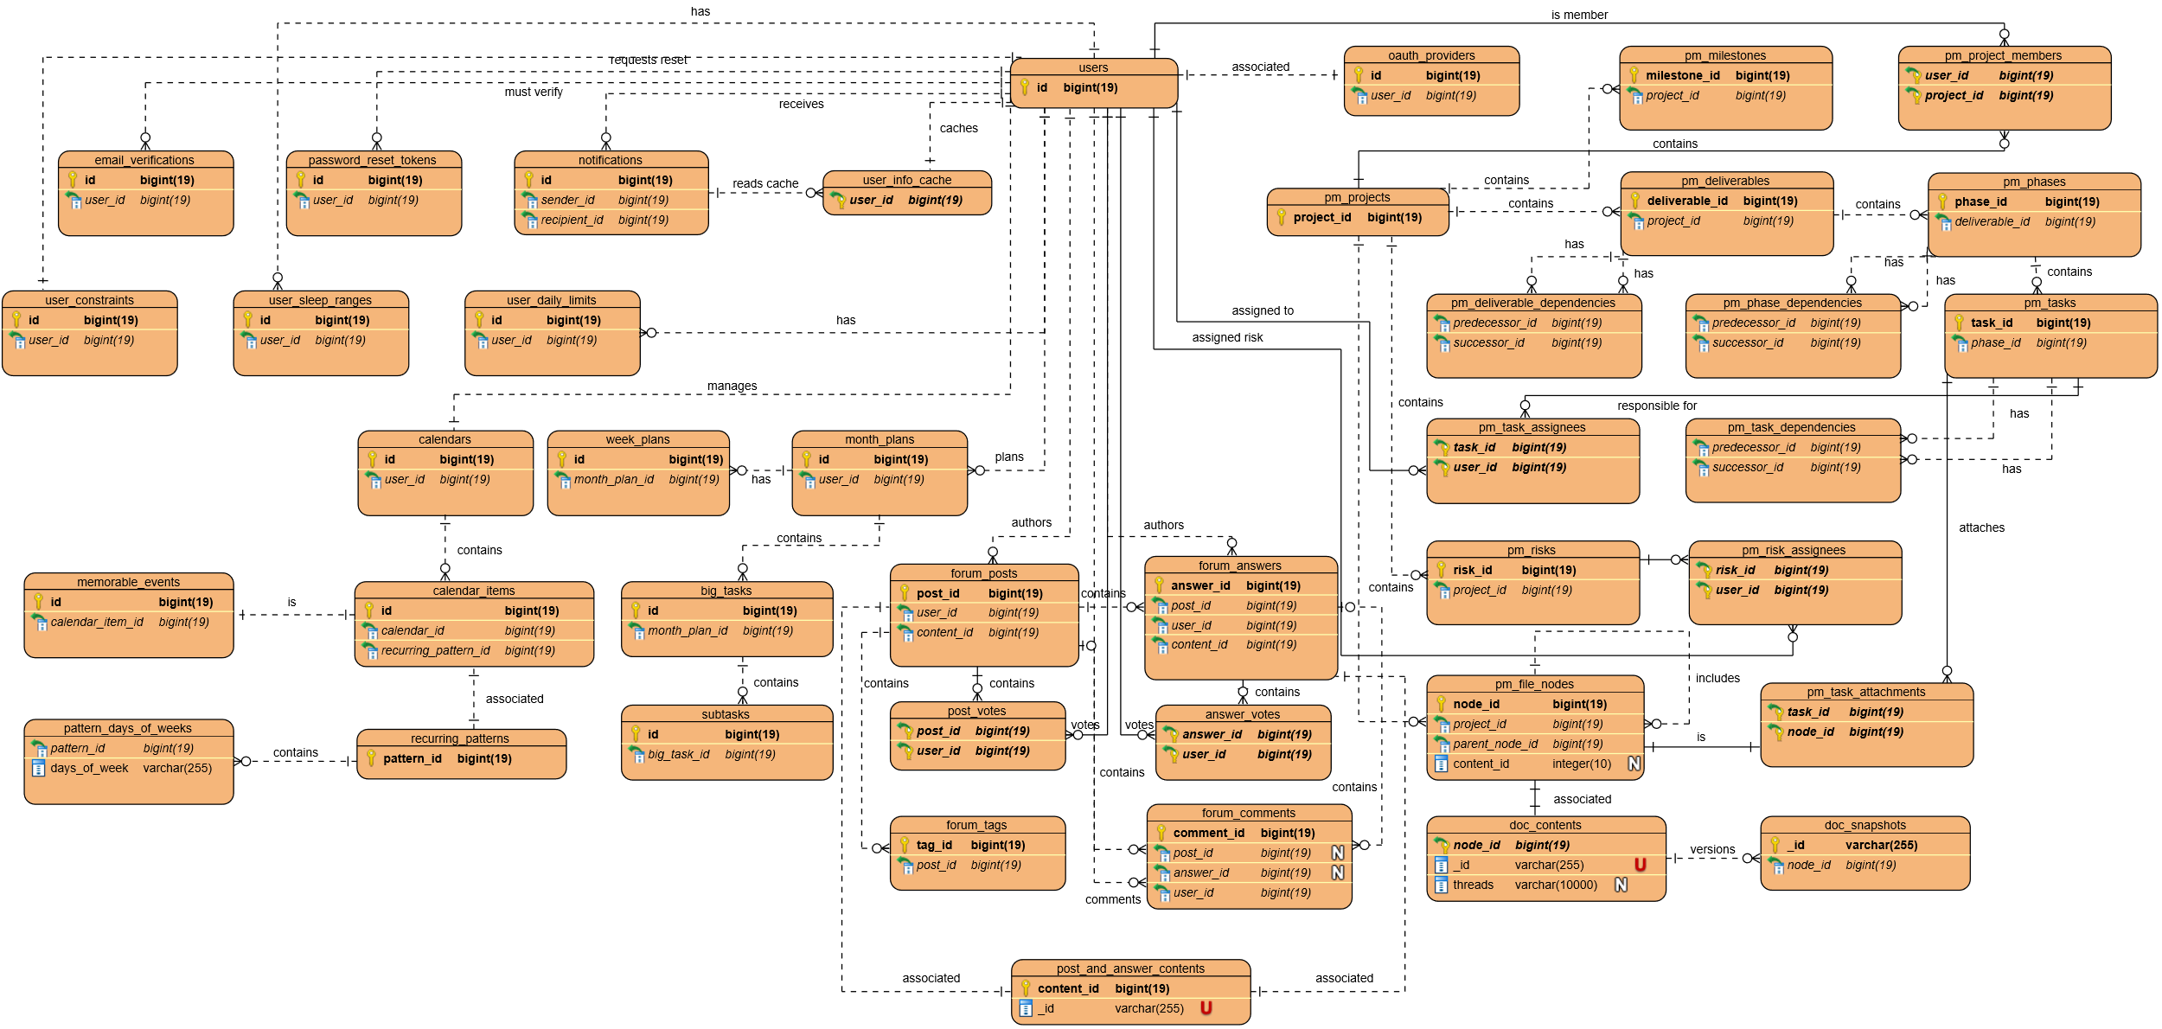
Overall system database

Slide 17
User Interface (UI) Overview
University graduation project
2021-2025

Slide 18
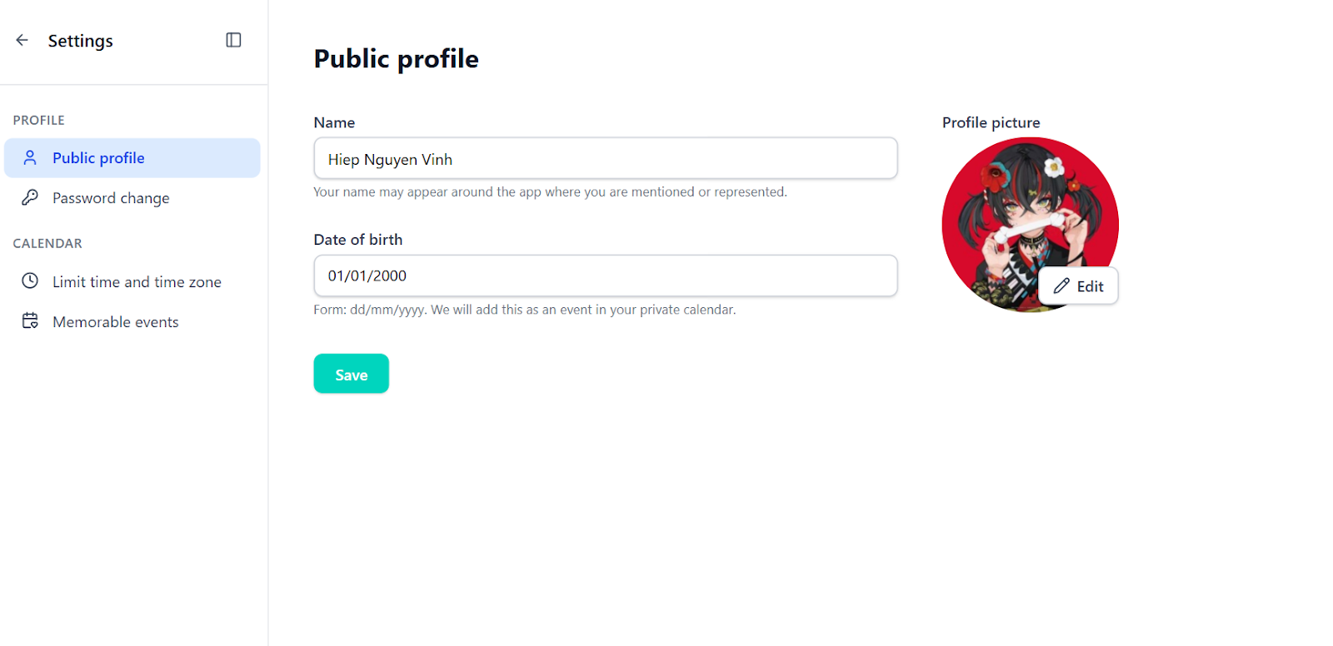
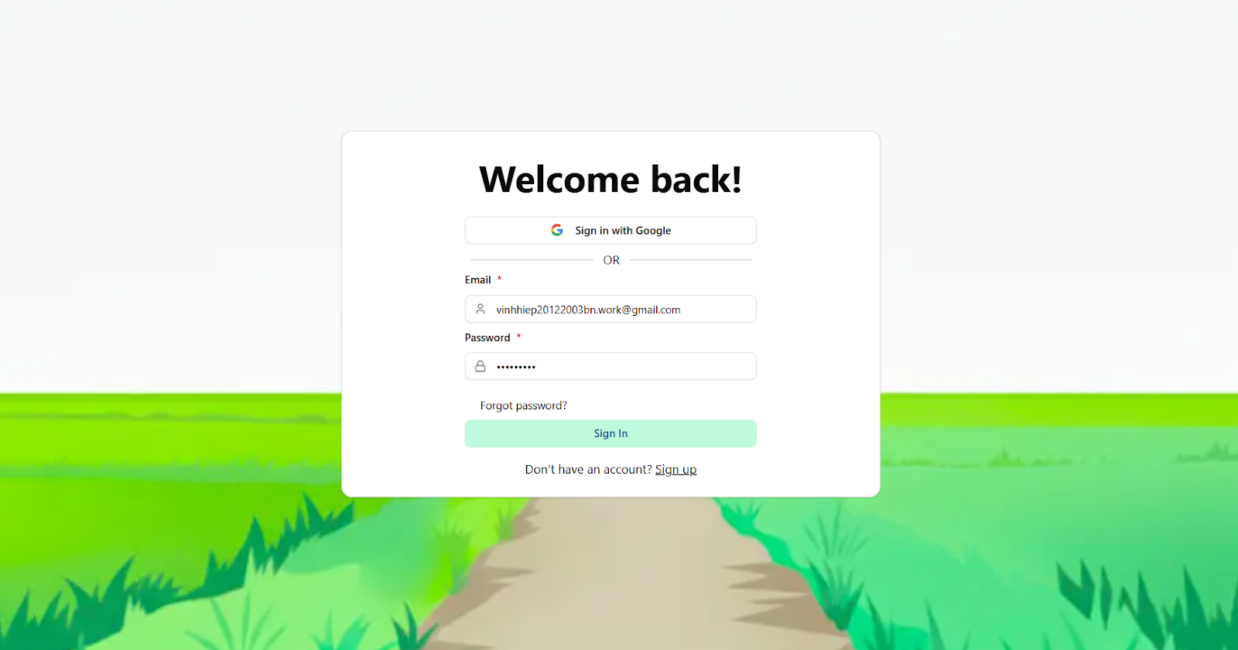

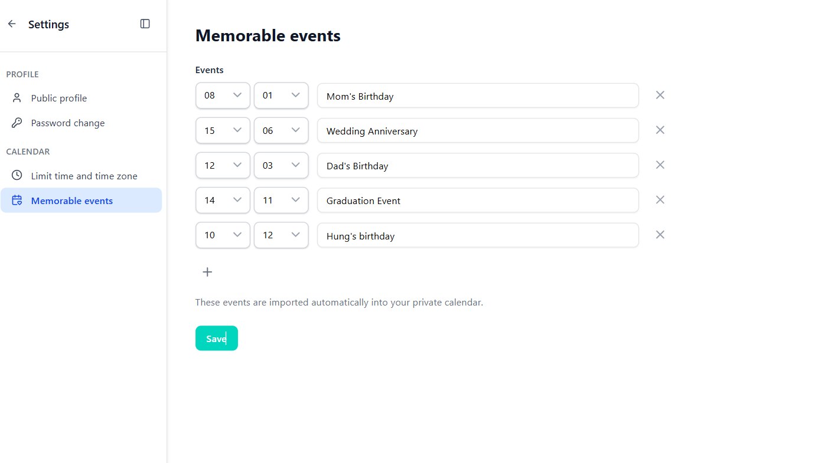
User Management interfaces
Interfaces for authentication flows, and personalized system settings

Slide 19
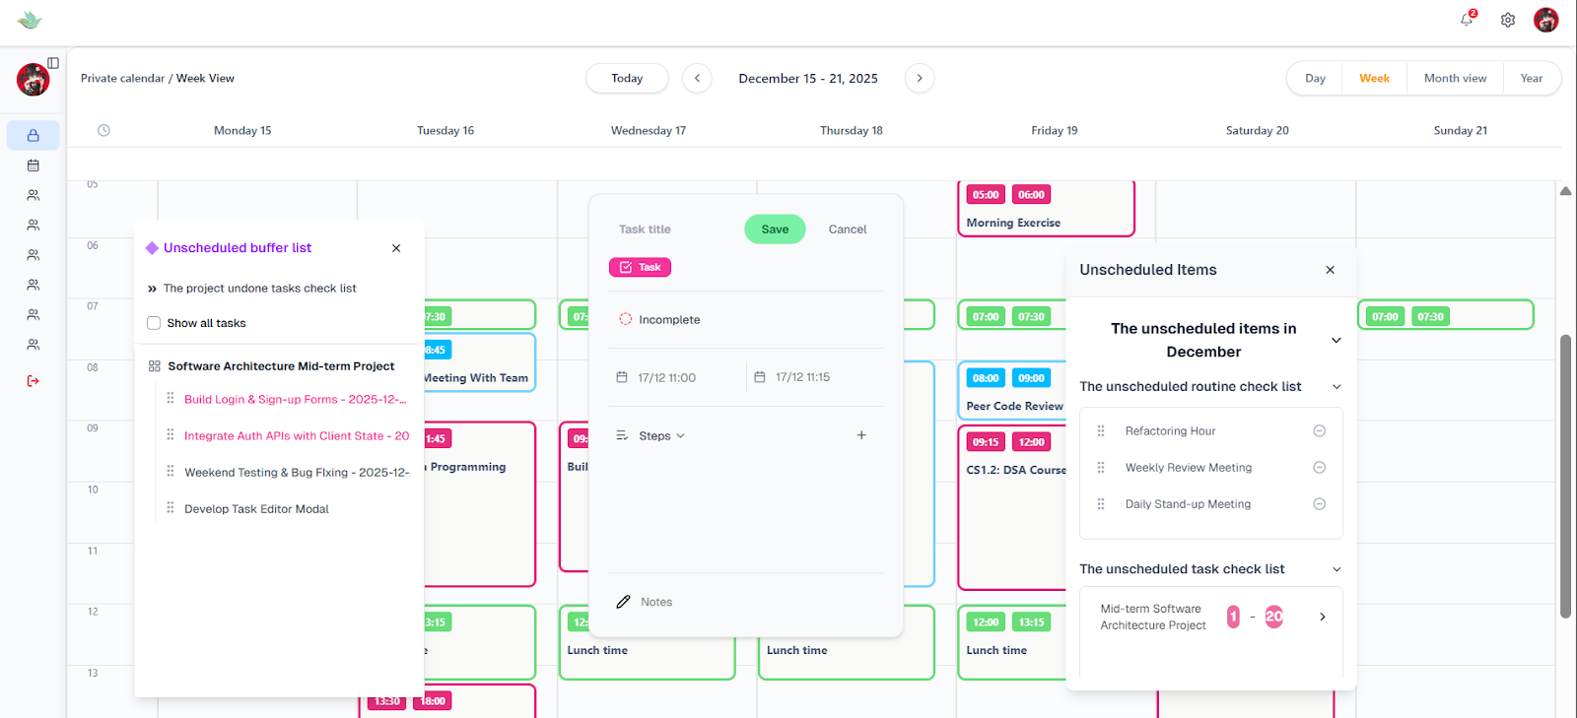
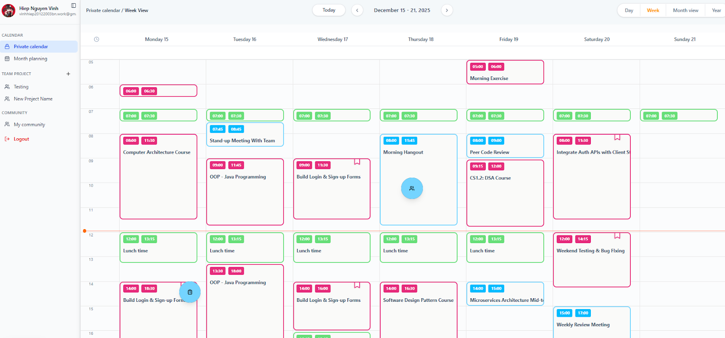
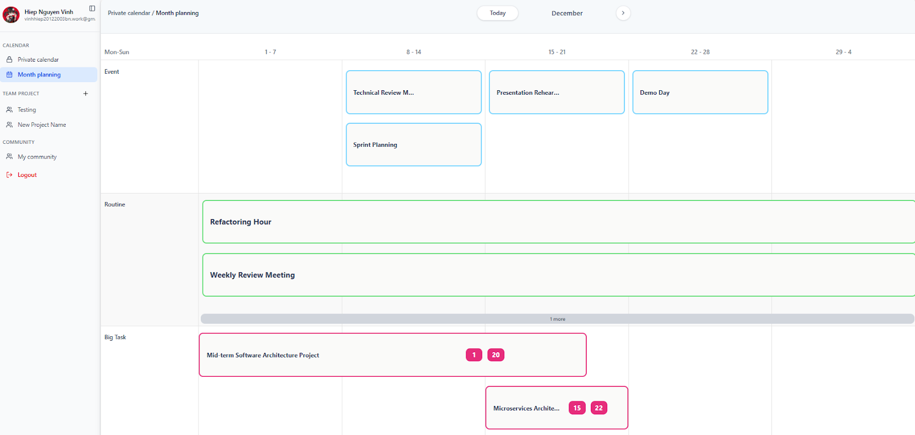
Personal Scheduling interfaces
Scheduling interfaces featuring synchronized private and team calendars

Slide 20
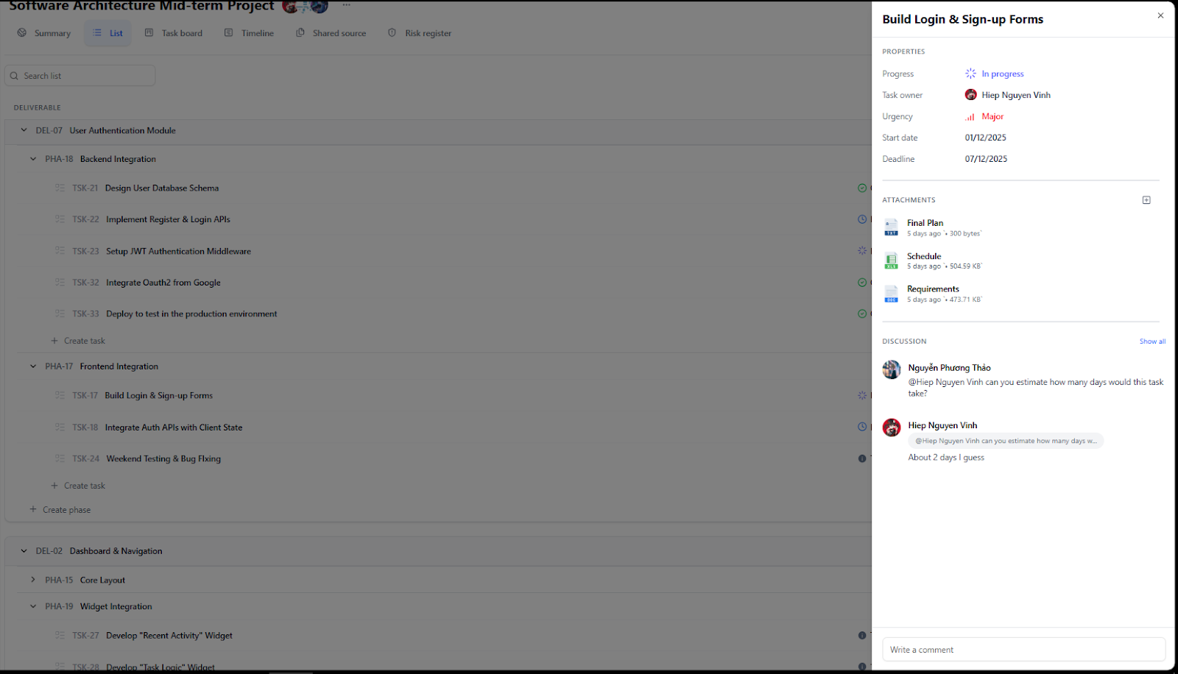
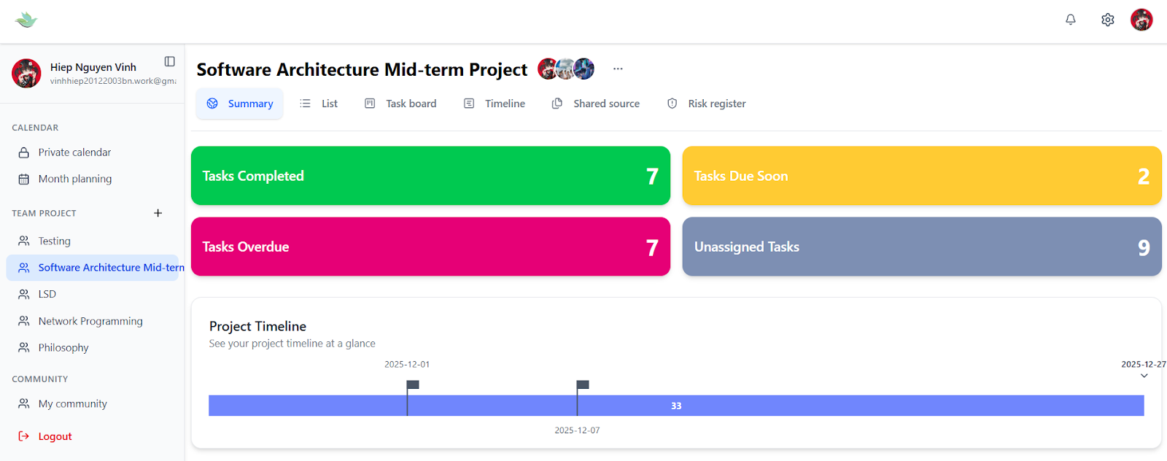
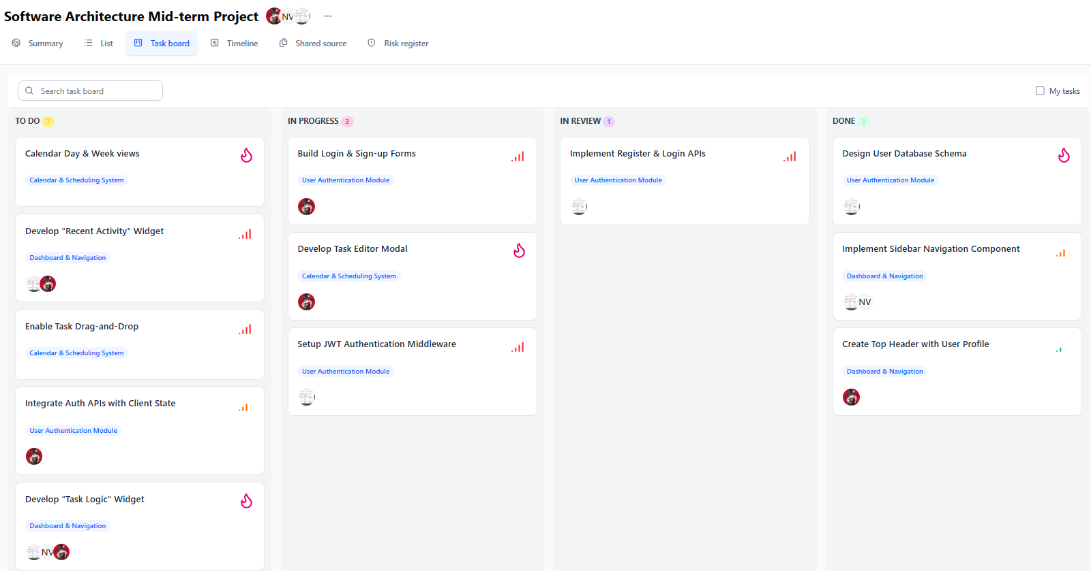
Project Management interfaces
A centralized project hub featuring interactive Kanban boards, risk tracking, and dynamic timelines for managing tasks and visualizing project metrics

Slide 21
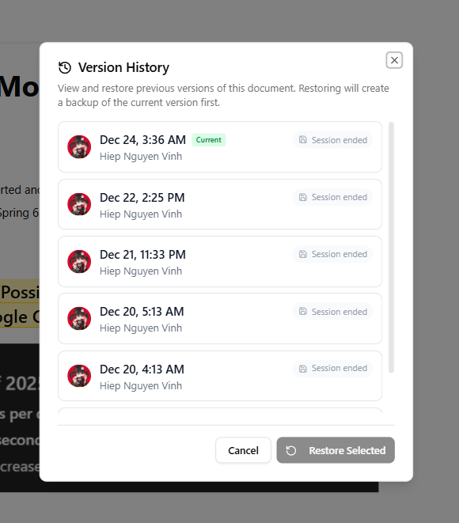
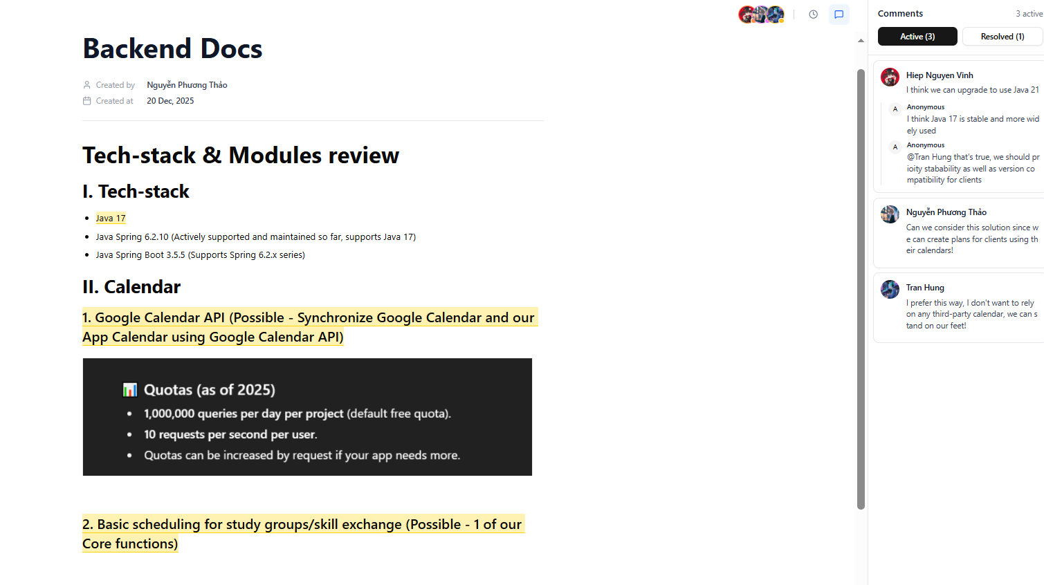
Document Management interfaces
A collaborative document workspace featuring real-time co-authoring, contextual commenting, and version history tracking

Slide 22
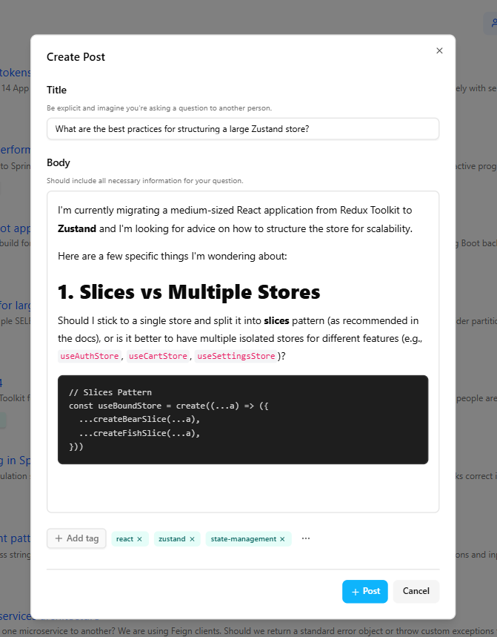
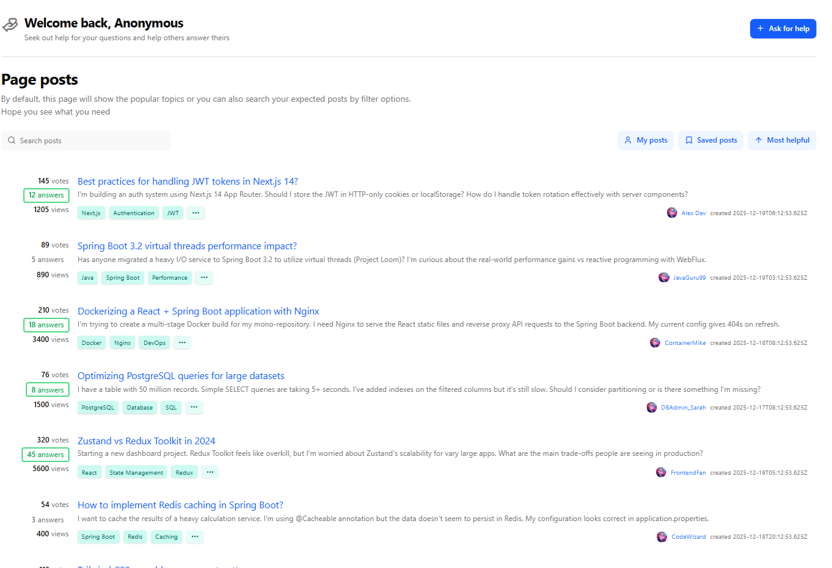
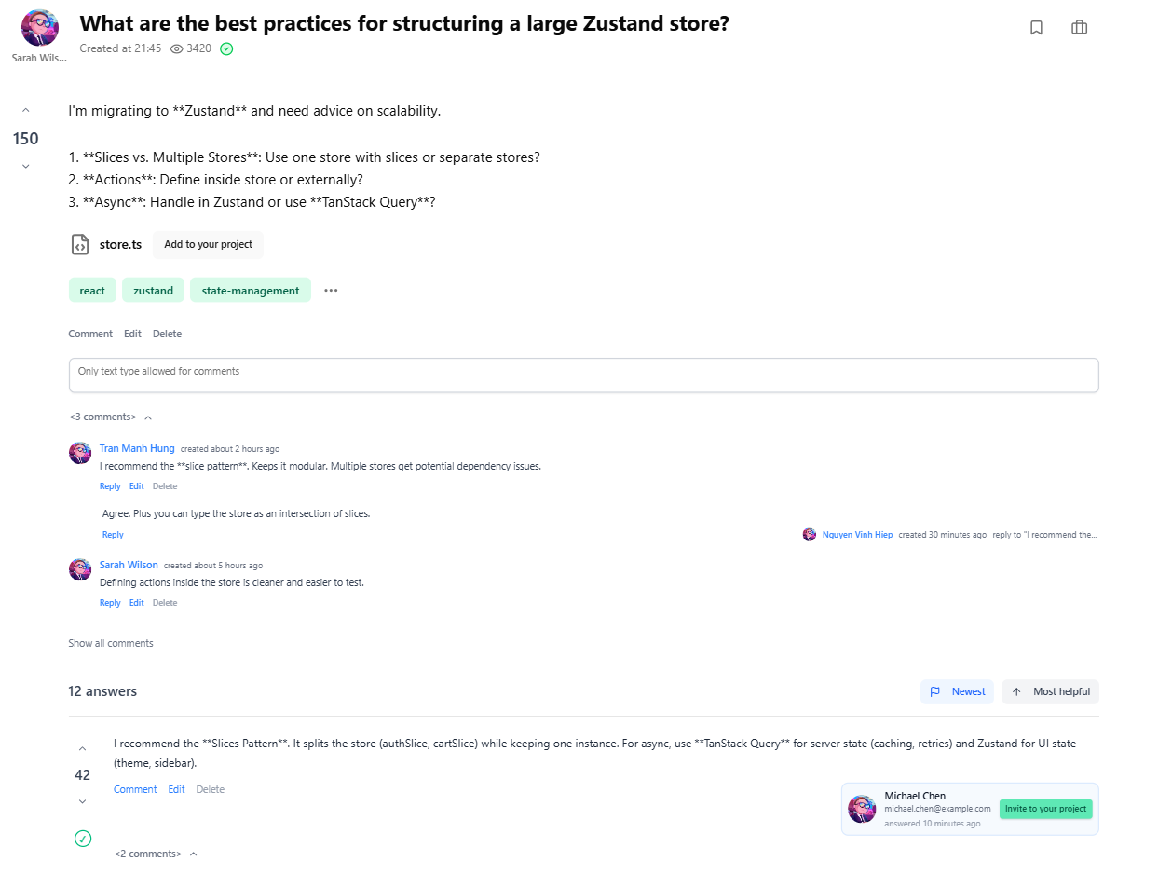
Forum interfaces
A knowledge-sharing hub featuring a dynamic post feed, discussions, and a community-driven voting and answer system

Slide 23












Achievements
Limitations
Future direction
Summary
01
02
03
A strategic recap of the project's milestones, current challenges, and the roadmap for upcoming development
Developed a decentralized ecosystem
Strategic Technology Adoption
User-Centric Design
Secure Authentication
Operational Complexity
Infrastructure Overhead
Idempotency Challenges
UI/UX Sophistication
Mobile Platform Expansion
AI-Driven Assistance

Slide 24
Thank you for watching
Do you have any questions?

